Slide 1









Project Equality Platform and Standard
Portuguese Standard
“Equal pay for women and men Management System”
State of the art
Portugal
Susana Santos
WORKSHOP | 12 November 2021
Programme Operator:
Project Promoter:
Project Partners:

Slide 2
National Standardization Body
Standardization Department
Strategic Goal
Portuguese Institute for Quality
Public Institute, under the Ministry of Economy
Promote and support
the development of the
Portuguese standardization activity,
in a credible and sustainable way,
aiming to systematically reinforce
the whole network of actors and users

Slide 3


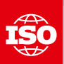



Portuguese National Structure
European Standards
Organizations
International
Standards
Organizations
Portuguese Institute for Quality
NSB
National Standardization Body
Sectorial Standardization Bodies
54
222
Portuguese
Technical Committee
+
4000 Experts

Slide 4

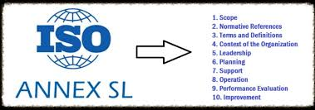
Created a Portuguese Technical Committee
(participant categories/stakeholders)
+
Is developing the standard Equal pay for women and men Management System
Standardization Process
In compliance with international and european rules, IPQ…

Slide 5




Portuguese Standard development Process
Technical Committee depends directly on the IPQ and in its constitution we have:
President - CITE
Secretary - IPQ
+
Strategy and Planning Office of the Ministry of Labour, Solidarity and Social Security
+
Other members (Total=28)

Slide 6




Portuguese Standard Development Process
EQUAL
PAY
Men Women

Slide 7
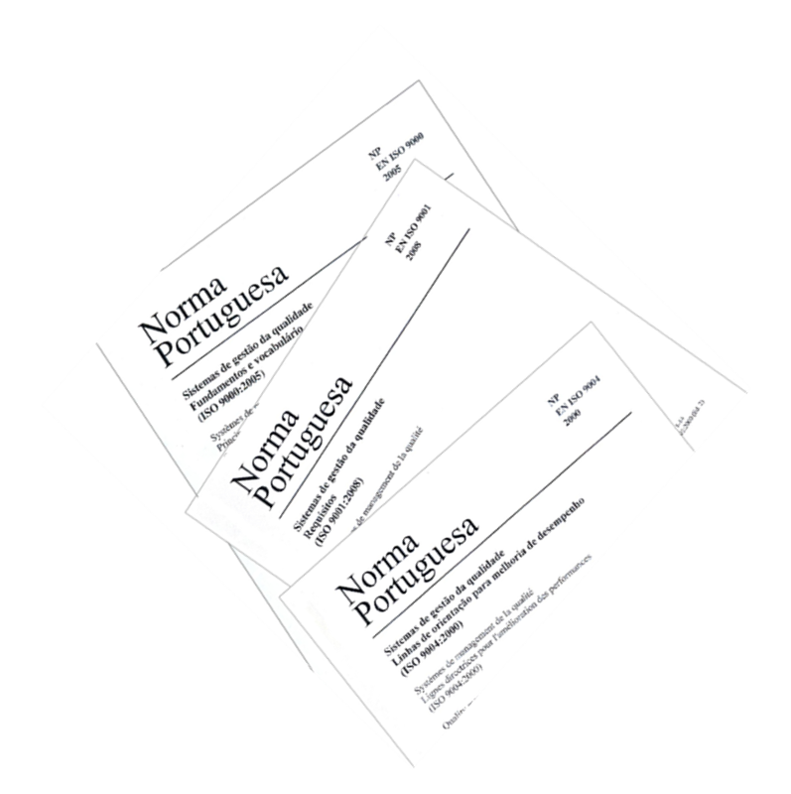

Portuguese Standard Development Process
How we organised ourselves??

Slide 8

Portuguese Standard Development Process
The TC 216 formed 4 Working Groups:
Group 1: APPLICABLE LAW/LEGISLATION
This group works on legislation relating to equal pay issues, including clarification of the concepts defined in the law
Group 2: METHODOLOGIES
This group works on the methodologies for determining the value of jobs and the tools available to support their implementation
Group 3: ANALYSIS OF THE ICELANDIC STANDARD
This group makes a detailed analysis of the Icelandic Standard in order to check what does not make sense in Portuguese context, and, on the other hand, to identify issues that do not appear in the Icelandic Standard and should be included in the Portuguese standard
Group 4: CERTIFICATION REQUIREMENTS
This group works on the aspects related to the certification requirements and the Management System methodology of the Standard (Annex SL)

Slide 9




Portuguese Standard Development Process
What has been done by each Working Group?

Slide 10

    Specific contents of the “Management Systems Standards”
    1. Scope
    2. Normative references
    3. Terms and definitions
    4. Context of the organization
    5. Leadership
    6. Planning
    7. Support
    8. Operation
    9. Performance evaluation
    10. Improvement
Portuguese Standard Development Process

Slide 11
ANNEXES
Anexo A - Applicable law (informative)
Anexo B - Studies and Reports (informative)
Anexo C - Good Practice (informative)
Anexo D - Checklist of procedures for the application of the Job Evaluation Methodology free from Gender Bias - Analytical Points Method (informative)
Anexo E - Practical example of the Job Evaluation Methodology free from Gender Bias - Analytical Points Method (informative)
Anexo F - Judgements and Opinions (informative)
Portuguese Standard Development Process

Slide 12

General considerations
Portuguese Standard development Process
Basic legal documentation: Constitution of the Portuguese Republic + Labour Code + Law n.º 60/2018, of 21 August - Measures to promote equal pay for women and men for equal work or work of equal value
Implementation the new edition of Annex SL - "Harmonized approach for management system standards", published on April 30th
Other Portuguese and international standards were also consulted to have a global alignment
The requirements of Portuguese Standard are applicable to any organization, public or private, regardless of its type, size, complexity, nature or legal personality, how and where the work is provided (e.g. teleworking regime, or remote working,....). It is applicable to all organizations, and must be complied with by the whole organization.

Slide 13
General considerations
Portuguese Standard development Process
The MS implements a Methodology for job evaluation free from gender bias - Analytical Method by points, to promote the continuous improvement of the policy for equal pay for women and men. Was added, also, a checklist of compliance with Methodology/Method. MS leads to us an organizational efficiency!
In the annexes we have included, among others, one related to good practices and another with a concrete example to facilitate the use of the Methodology/Method referred above. And an alphabetical index of terms at the end.
The requirements set out for this Standard are applicable to any organization and must be complied for all the organization - all its functional units
Our main concern is that the requirements of the standard are objective, clear and understandable by everyone (from micro-companies to GEs)

Slide 14


Group of lawyers tasked with designing the applicable EU and national legislative framework on equal pay.
Prepare text proposals for the Preamble and Introduction and for chapters 1 - Objective and field of application, 2 - References and 3 - Terms and definitions.
It compiled the relevant legislation and documents to integrate Annex A and B, and the Judgments of national and EU Higher Courts and the CITE Decisions to be part of Annex F.
Most relevant legislation in this area: Law 60/2018, Articles 23 to 31 of the Labour Code and Articles 58 and 59 of the CRP.
Portuguese Standard development Process
Coordination - CIG
Group 1: APPLICABLE LAW/LEGISLATION
5 Meetings

Slide 15

Portuguese Standard Development Process
Coordination – MTSSS/GEP
Group 2: METHODOLOGIES
This Group is composed by people from the public administration, academia and social partners.
Based on ILO Guide “Gender-neutral job evaluation for equal pay: a step-by-step guide”, Group 2 is working on the methodology for determining the value of jobs without gender bias and the tools to support their implementation.
The approach used is the analytical points-factor scheme (usually referred to as a point method) which is based on breaking down jobs into factors (qualifications, effort, responsibility and conditions under which the work is performed), subfactors and their levels and attaches scores to each level.
The main goal is to set out the various methodological components of the process and explain the criteria which should be comply in order to avoid discriminatory pay practices between women and men.
A checklist has been also prepared for quick reference for users.
9 Meetings

Slide 16


Portuguese Standard development Process
Coordination - CESIS
Group 3: ANALYSIS OF THE ICELANDIC STANDARD
As a starting point:
- Detailed analysis of the Icelandic Standard and its potential of transferibility to the Portuguese context.
In the course of the work:
Reading and commenting on the several versions of the Standard in order to ensure coherence between the different sections and annexes, as well as readability and objectivity of the contents, namely from the perspective of the organizations that will implement the Standard.
Elaboration, in course, of the Alphabetical Index and the Bibliography.
11 Meetings

Slide 17

The main focus of this Group has been assuring:
- alignment of the PT standard with the ISO high-level structure
- objective and understanble standard requirements
- an output of auditable requirements
- terminology coherence with other social accountability PT standards and ISO standards
Portuguese Standard development Process
Coordination - BV
Group 4: CERTIFICATION REQUIREMENTS
Most members in this group are experienced auditors from accreditation and certification bodies and have been briefed on the OIT methodology: Promoting Equity. Gender-neutral job evaluation for equal pay: a step-by-step guide.
What is doing?
- Initial full standard requirements review has been performed and clarifications have been required to the other working groups
- Annex D (informative) has had several reviews and is now completed (WG 2 + WG 4)
- Suggestions and awareness raised to the TC relating specific issues
Other groups are invited to GT 4 meetings as applicable, thus making the best use of the technical and scientific expertise of other members of the TC.
11 Meetings

Slide 18
General State of art at the current date
- The standard is written in its generality (60% done)
- We held more than 50 meetings ranging from plenary meetings, WG meetings and Portuguese partnership meetings (very participative and dynamic sessions!)
- TC has an advanced Draft of all sections (NP has about 100 pág.)
- We are always making many changes to the “wording” because our main concern is that the requirements of the standard are objective, clear and understandable by all (from micro to large companies)
- Drafting of Annex D - Checklist of procedures for the application of the job evaluation Methodology/Method
- Drafting of Annex E - Practical example of application of the Methodology/ Method
Portuguese Standard development Process

Slide 19

General State of art at the current date
- The requirements established for this Standard are applicable to any organization, public or private, regardless of its type, size, complexity, nature or legal personality, "how and where" the work is provided (e.g. teleworking regime). It’s applicable to all organizations and must be complied with by the whole organization - all its functional units - should the organization wish to obtain certification
- We used inclusive language in all standard (male/female)
- Some groups worked in parallel to facilitate the technical understanding of the Methodology/Method to be applied in the standard
- We are finalizing the Section 8 and its impact on following sections (4 to 7)
- Updating of Section 3 and the alphabetical Index
- All jobs should be considered - female, male and neutral
Portuguese Standard development Process

Slide 20

Main Challenges
- Comply with all project deadlines, in each of its phases
- Obtain consensus among all stakeholders involved
- Assess what should or should not be included in the standard, given the relevance of the topic, versus the fact that the standard is already too extensive...
- Disseminate the standard in an appealing way to encourage its acquisition and application by the user, in order to be truly applied and transformer to our society
Portuguese Standard development Process

Slide 21

NEXT STEPS …
- Revised all sections, because are written but aren’t all revised!
- Assess which terminology is actually useful to include in the standard!
- Ensure coherence and consistency of the wording and technical content throughout the standard, given its “big size”!
- Continue to work hard to fulfil all the project tasks and deadlines!
Portuguese Standard development Process

Slide 22
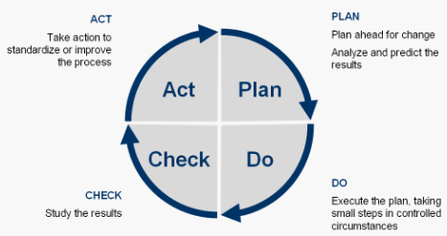

Stages to develop the Portuguese Standard
DATE | ACTIVITY
January - February 2020 September 2020 | Established the Portuguese Technical Committee (TC) 1.^{st} Meeting of the Portuguese TC and definition of work’s methodologies Translation of Icelandic standard ÍST 85:2012 (EN to PT) is finished
October 2020 - April 2022 (aNP) | . Portuguese TC meetings to build the “Equal pay for women and men Management System”, according to the Deming cycle (methodology PDCA) - Preliminary draft (PD) and Committee draft (CD) . Portuguese TC approves by consensus the CD and sends to IPQ
May – June 2022 (prNP) | . IPQ verifies/checks: - Normative Consistency with the Rules and Procedures of Portuguese Standardization - Public Inquiry Procedure . After approval of IPQ, the normative document becames a Standard Project and IPQ does editorial formatting (receives a n.º) . Portugal notifies CEN - European Committee for Standardization (iProjex)
November – December 2022 (if possible antecipate to July) | National Public Inquiry/Consultation . During the Inquiry stage IPQ receives public comments about the projet standard and sends to portuguese TC to evaluate . TC appreciates the comments made by society, answers who commented and decides on their integration, by consensus . TC sends the Final Project of the standard to IPQ
January 2023 (NP) January - February 2023 | . IPQ verifies/checks: - Normative Consistency with the Rules and Procedures of Portuguese Standardization - Procedure of homologation/ratification and edition . IPQ does editorial formatting and the normative document becames a Portuguese Standard . Production of a Fact Sheet
15 February 2023 | Edition of the Portuguese Standard “Equal pay for women and men Management System”
February - April 2023 | Dissemination of the Portuguese Standard

Slide 23

Edition of the portuguese standard…
15-02-2023
Equal pay for women and men Management System
+ Fact sheet
+ Dissemination

Slide 24



Let’s take a look at the portuguese standard!!!...

Slide 25

The End! ssantos@ipq.pt

