Slide 1
Equal pay challenges in Iceland
Workshop with Project Equality Platform and Standard
Lisbon, Portugal, November 12 2021
Gyða Björg Sigurðardóttir
From management consulting firm Ráður
www.radur.is

Slide 2
Scope of this presentation
The focus will be on difficulties and constraints in implementing the standard for Icelandic industries and institutions. This presentation does not build on research and can therefor not be used to make assumptions without further investigation. All opinions stated are the responsibility of the author and do not represent the opinion of any other interested party.
Where innovation can help
Where authorities need to help
The problem and the solutions
The legal framework and audit firms
Through our work with costumers we address equal pay with:
What we hope to achieve
What challenges we face
How we hope to overcome those challenges
Leadership
Knowledge
Technology
The legal framework and processes of audit firms create certain problems like:
Inconsistency in requirements
Unclear demands
Do not address pay transparency

Slide 3
About us
Anna Beta
Gyða Björg
Bsc. Management engineering
Msc. Civil engineering
Our team
Falasteen
Bsc. Business, MPM
Sustainability, human recourses and market wage analysis
Management, audits and quality control
Wage analysis, operational research and BI
Ráður was founded in 2018
Bridging the gap between technology and sustainability
Focus on service and innovation in equality

Slide 4
Disclaimer
This presentation does not build on research and can therefor not be used to make assumptions without further investigation. All opinions stated are the responsibility of the author and do not represent the opinion of any other interested parties.
Gyda Bjorg

Slide 5
Consultant’s job
Strategy and Training
Analysis
Understanding the challenge
Our role as consultants varies depending on the tasks needed solving.
We work with a variety of companies and public entities.
Every entity has its own struggles.
Review and Audit process
Operating and Maintaining

Slide 6
Customer’s classification
From 2018 - 2019

Slide 7
Customer’s classification
From beginning to now

Slide 8
When we met two years ago
In Iceland

Slide 9
5 steps of implementation
Strategic planning
Job classifcation
Managing and documenting
Wage analysis
Review and audit

Slide 10
Equality management
Required basis for successful implementation

Slide 11
Leadership
1

Slide 12
Just tell us what we need to do to comply
Anonymous CEO

Slide 13
Leadership first
Direction
Vision
Time and money
Leadership
Middle management can not pull the weight without support
Allocating resources, responsibilities and time.
Leadership is ultimately what defines the outcome of equality implementation

Slide 14
In the absence of leadership
Profit first
Self-interest
Minimum effort
Leadership
There will be no change
This applies to all industries, cross sector
Notes:
If governments put a pressure on their institutions without leadership
Noise
If government puts pressure on private companies and there is no internal leadership
Bias

Slide 15
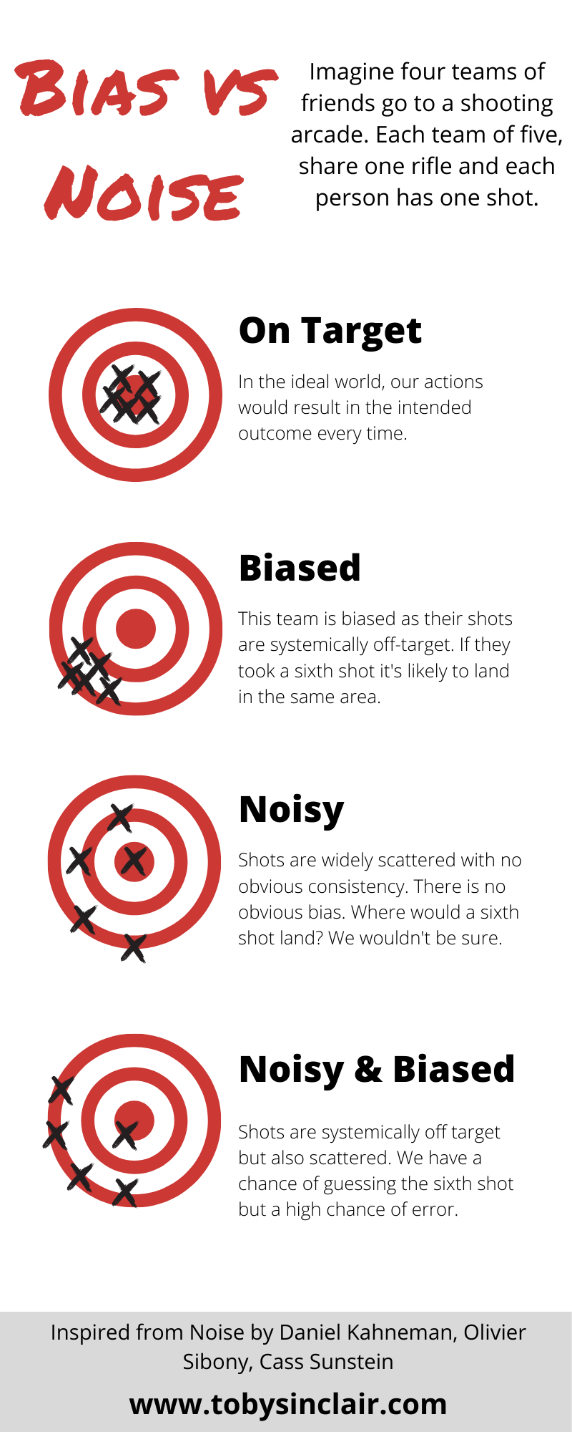
Understanding the impact of lack of leadership
Let’s borrow terms from statistics
In the absence of leadership we do not correct for bias or noise .
In order to know where we are going we need to have a target, know how to measure it and understand how different ideas affect the input and outcome .
-Concept from Noise by Daniel Kahneman et al.

Slide 16
On target
Purpose, target and vision align
Equality is well defined
Strategy
Engagement
Commitment
Path to equality is guided
Clear goals
Clear metrics
Bias and noise is known
Frame
Flexibility
Transparency
Legal framework is supporting
Clear purpose
Incentive

Slide 17
The problem with wage focused goals

Slide 18
Output oriented metric

Slide 19
Does not measure the underlying system

Slide 20
Metrics

Slide 21
Knowledge
2

Slide 22
Everyone gets paid according to their collective agreement
Anonymous payroll

Slide 23
Interdisciplinary
The standard combines different schools of thought
Human resource management
Quality control
Analysis and statistics
Labour market

Slide 24
Building know how
Evaluate the knowledge needed
Put together a team
Seek training or consultation

Slide 25
Technology
3

Slide 26
What do we need to change to get a 0% outcome?
Anonymous HR manager

Slide 27
Documentation
Procedures, forms and reports
Information technology
Managing procedures

Slide 28
Payroll
Pay spans, job titles etc.
A lot of time is wasted preparing data afterwards
Systems should support change
Job titles
Job descriptions
Pay structure

Slide 29
Analysis
Measuring what matters
Infrastructure and technical solutions
Methods of analysis
Regression and Means
Gender gap reporting

