Slide 2
- The standard review process

Slide 3
Survey - Implementation of Equal Pay certification
The Department of Equality in the Prime Minister's Office in Iceland has made three surveys on the implementation of equal pay certification among the companies and institutions that have received equal pay certification.
The latest survey is from December 2020 and was sent out to 347 companies and institutions. The response rate was 63%.

Slide 4
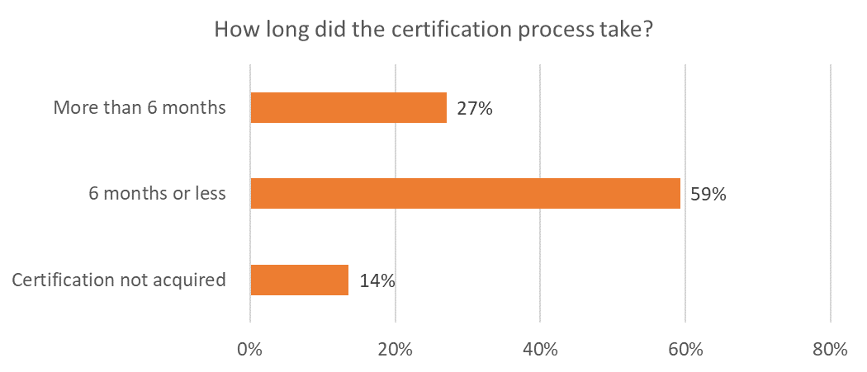
The process…

Slide 5
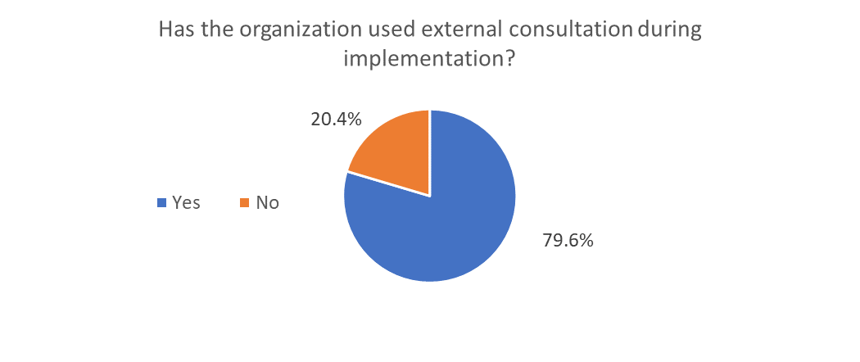
Consultation…

Slide 6
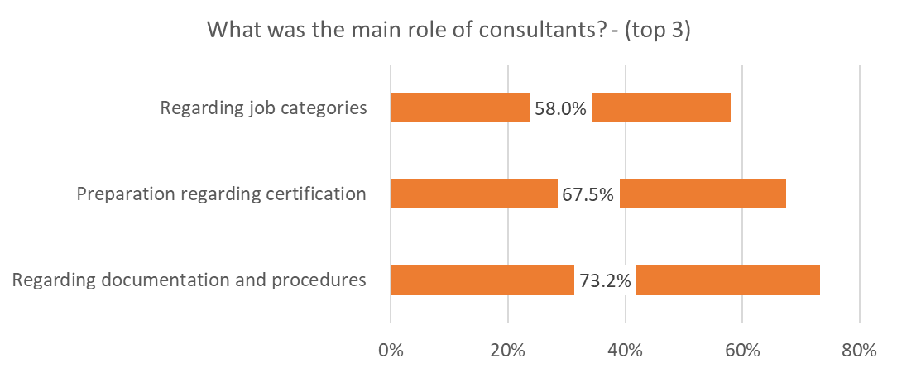
Consultation…

Slide 7
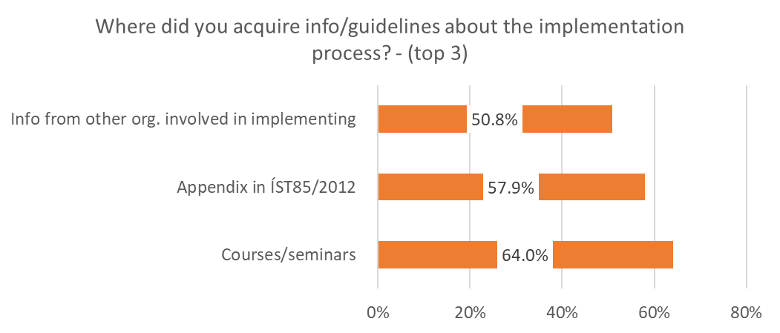
Information…

Slide 8
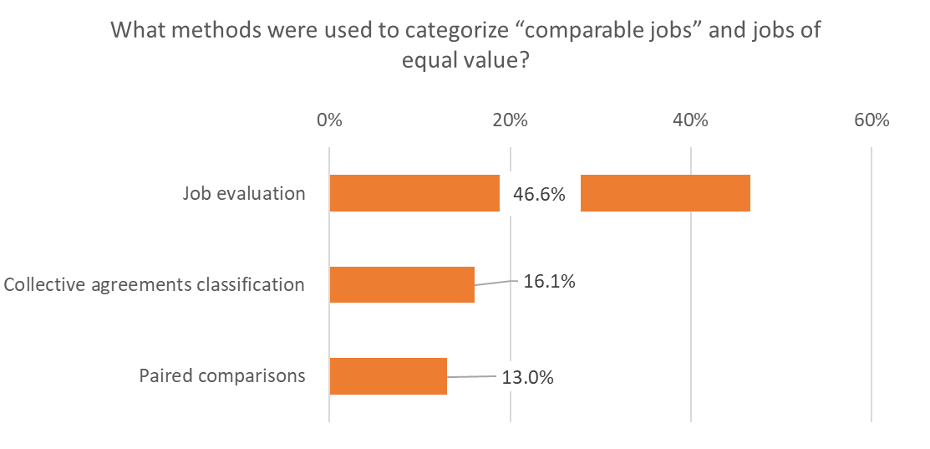
Methods…

Slide 9
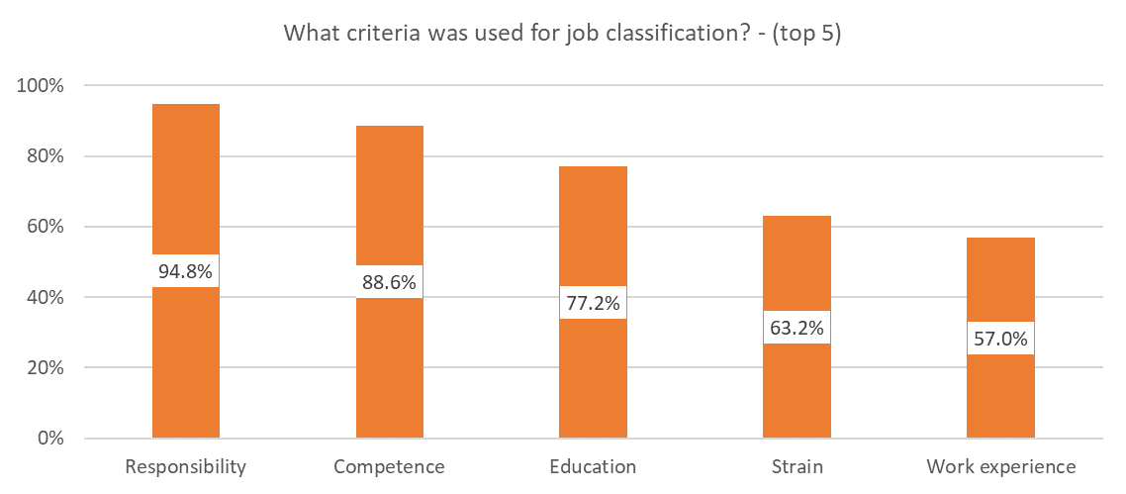
Classification…

Slide 10
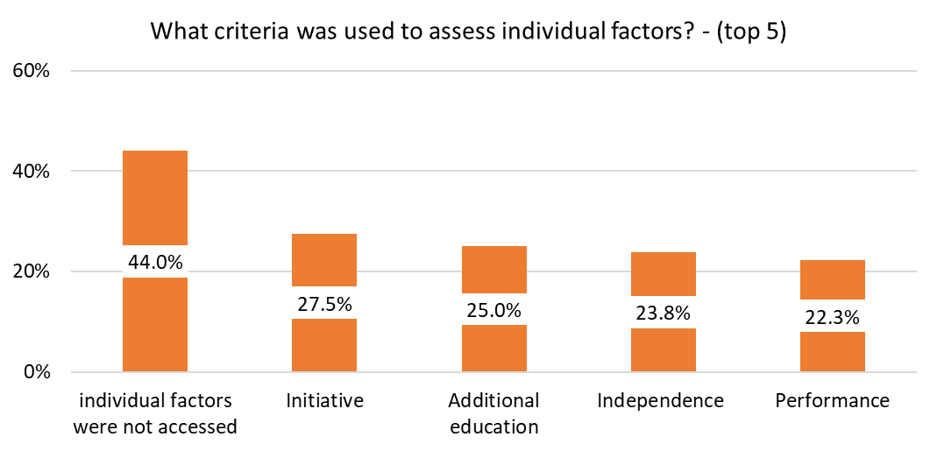
Individual factors…

Slide 11
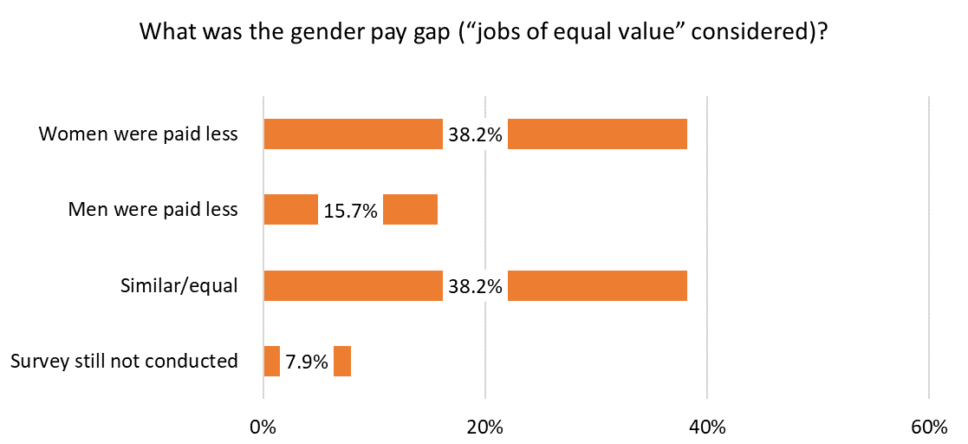
Equal pay survey…

Slide 12
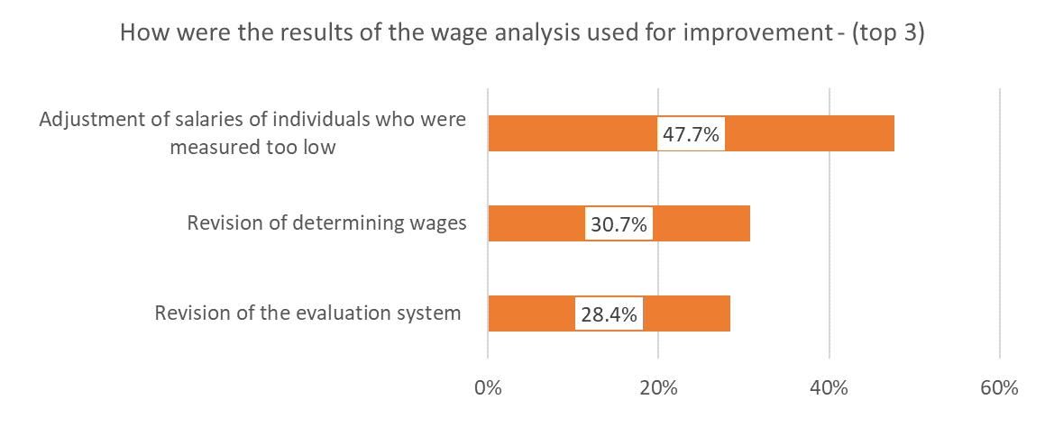
Improvements…

Slide 13
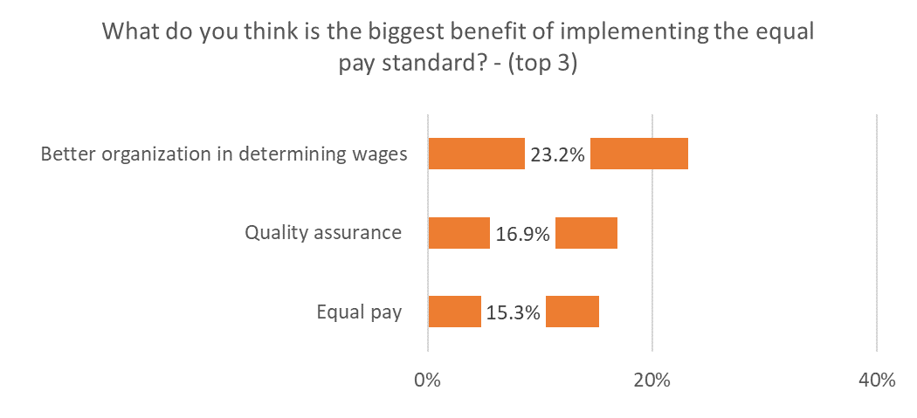
The benefits…

Slide 14
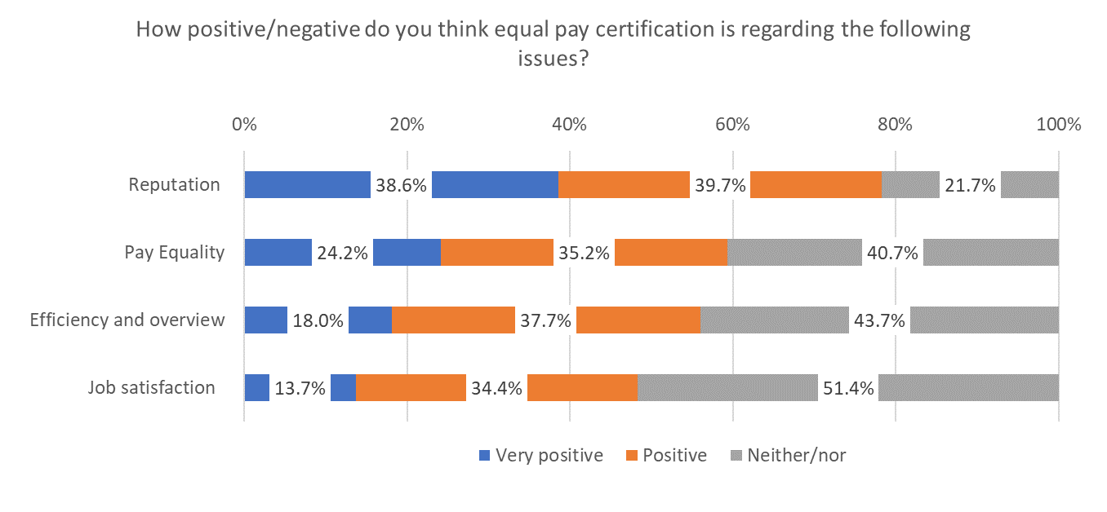
The positive…

